Slide 1
Logistics
Biweekly classes (Friday 3pm to 5pm)
Would not be covering Python as a programming lang. Would start off with NumPy and Pandas
Would be covering theory and practical's
Some assignments to try out what you learnt.
Solutions might be discussed in subsequent classes.
Topics to be covered are still work in progress
We would like this to be a knowledge sharing initiative so please contribute topics based on your own research and in your subject areas
A major intention is for people to figure out AI use cases in their own respective projects and also help to implement solutions ☺

Slide 2
Topics to be covered ( Still work in progress)
Numpy, Pandas, plotting libraries and sk-learn
Supervised Algos
Unsupervised Algos
Feature Engineering
Time Series Forecasting
Deep Learning
Natural Language Processing
Computer Vision Algos
SOTA algorithms discussions

Slide 3
Overview of AI Algorithms

Slide 4
Objective / Agenda
Broad overview
Toy and real world examples
Not Deep Dive
Would be covering the below areas today
Data Analysis
Classification
Regression
Clustering
Deep Learning
Reinforcement learning

Slide 5
Data Science Life Cycle
Understand the business problem to be solved.
Data Acquisition : ETL , Backend scripts [DB,Data Warehouse,Spark etc..)
Data preparation (Cleaning, pre processing)
EDA (plots, hypothesis testing, slicing and dicing of data
Modelling, Evaluation and Interpretation
Communicate results: clear and simple
Deployment : Engineering (ML Ops setup)
Real world testing A/B testing to see the actual model performance and measure the actual business value.
Business buy-in, Can use the A/B testing results for this.
Operations : Retrain models, handle failures, process
Optimization : improve models, more data, more features and optimize code

Slide 6
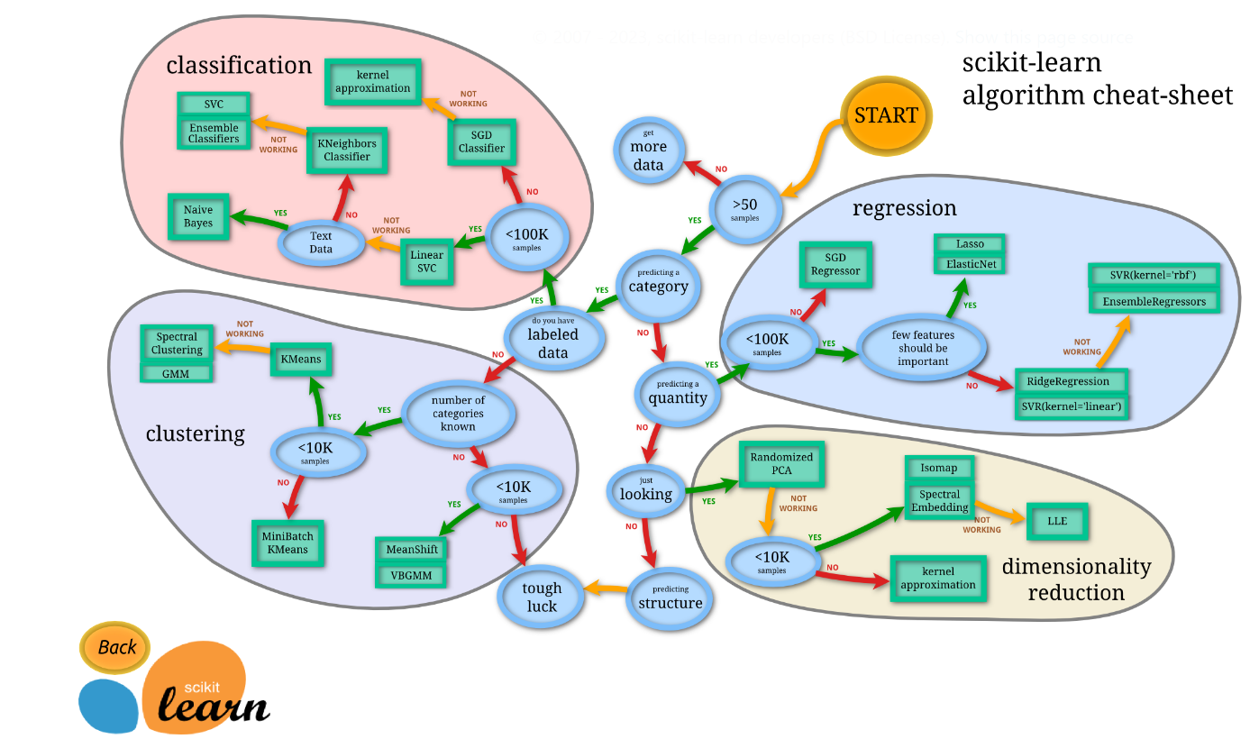
Algorithms Overview
https://scikit-learn.org/stable/tutorial/machine_learning_map/index.html

Slide 7
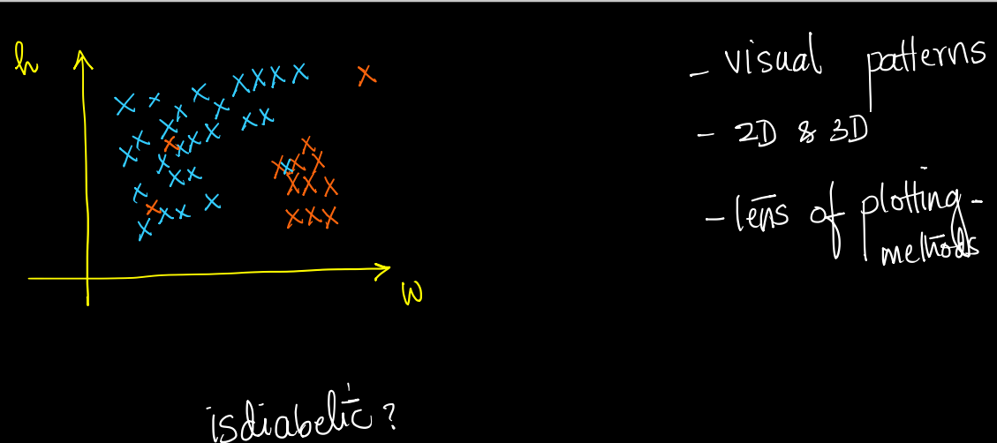
Data Analysis : Plotting
Red markers : Diabetic
Blue Markers : Non Diabetic
Simple plots indicate simple
visual patterns which can be used
to establish that heaver people are
more prone to diabetes.
There are hundred’s of plotting
Techniques.

Slide 8
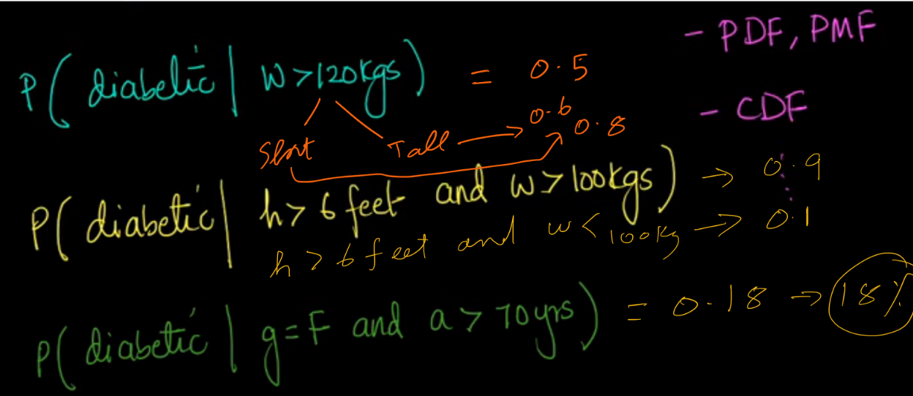
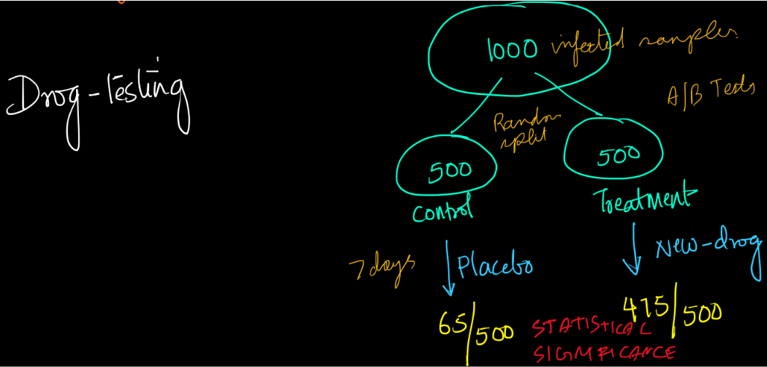
Data Analytics ( Probability / Stats)

Slide 9
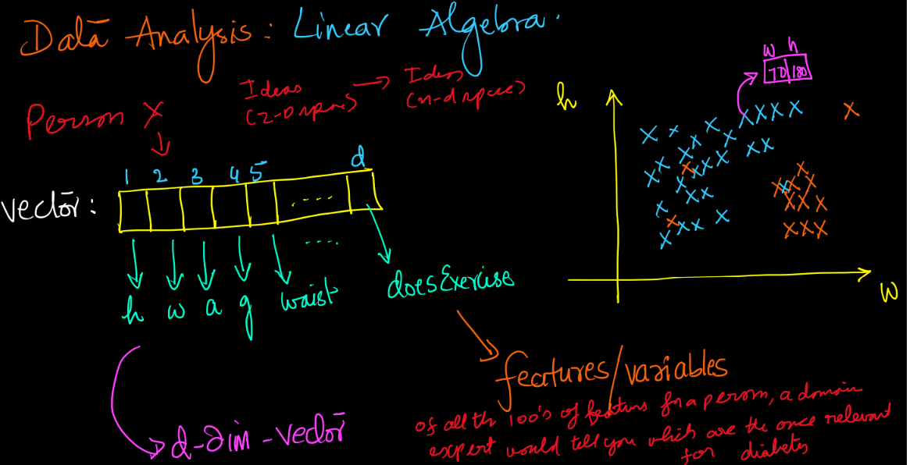
Data Analysis : Linear Algebra

Slide 10
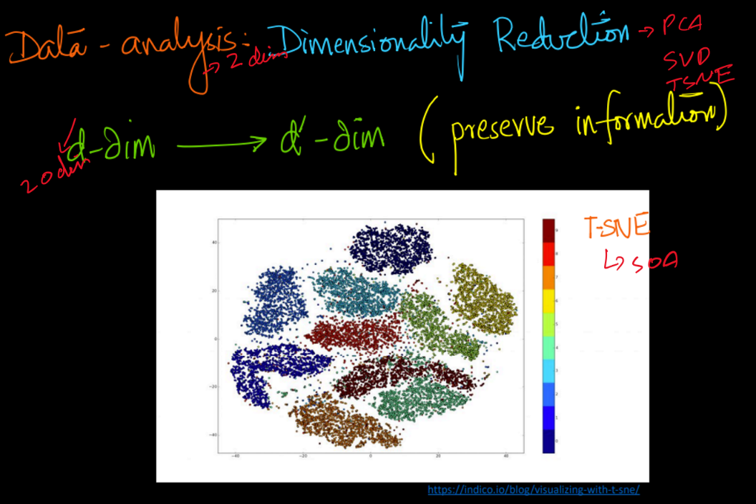
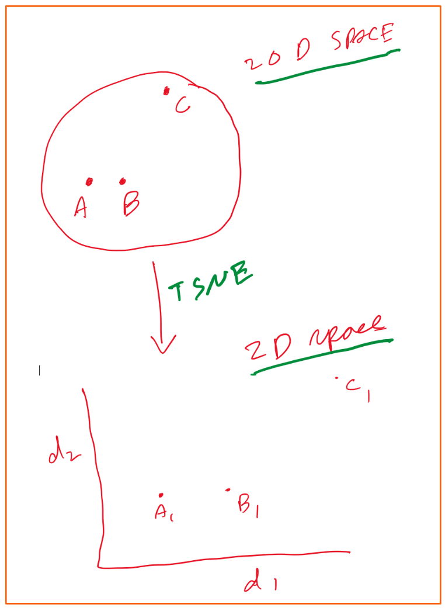
Data Analysis : Dimensionality Reduction
https://indicodata.ai/blog/visualizing-with-t-sne/
t-Distributed Stochastic Neighbor Embedding :
Ensures that neighbour’s in a high dimensional space are also neighbours in a low dimensional space that retains lot
of original information. Just need
A way of creating such embeddings which convert a idea in a high dimensional space to a lower one
while preserving neighbourhoods.
T here basically refers to t-distribution which is a type of probability distribution.
Other algorithms are SVD, PCA etc..
Notes:
TSNE is a really cool computer algorithm that can help us see how things are related to each other. Imagine you have a bunch of pictures of different animals, and you want to figure out which animals look similar to each other. TSNE can help you do that!
TSNE takes all the pictures and tries to arrange them in a way that makes sense. It puts similar pictures close together, and different pictures far apart. And it does all of this on a computer screen, so you can actually see which animals are similar to each other.
But it's not just for pictures of animals! TSNE can work with lots of different things, like words or numbers. It's really useful when you have a lot of data and you want to understand how everything is related.
So that's TSNE in a nutshell - it's a computer program that helps us see how things are related to each other.

Slide 11
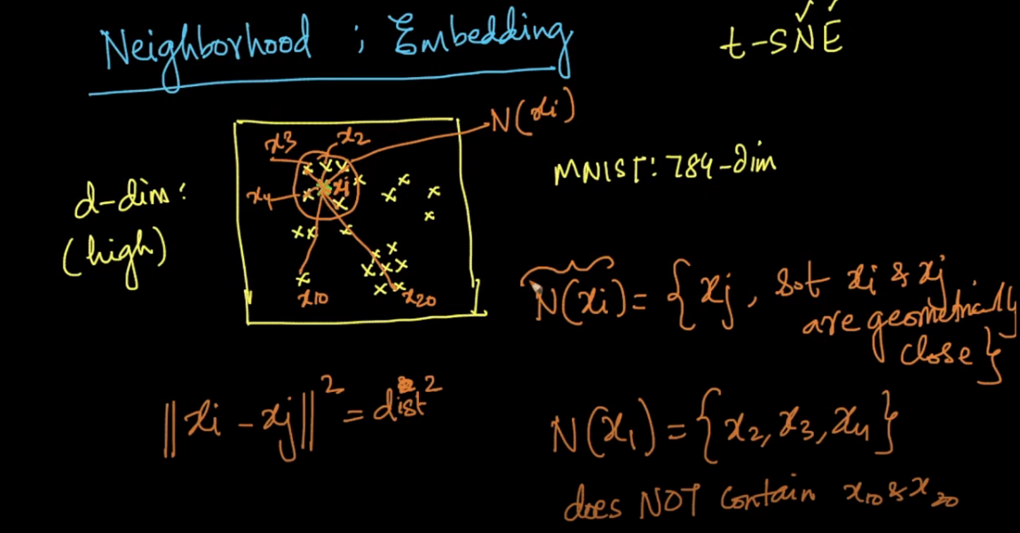
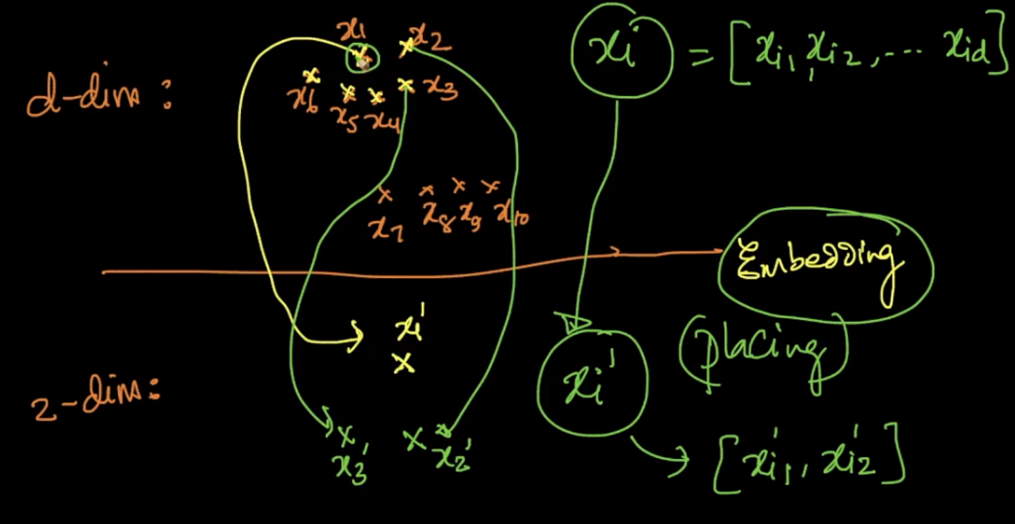
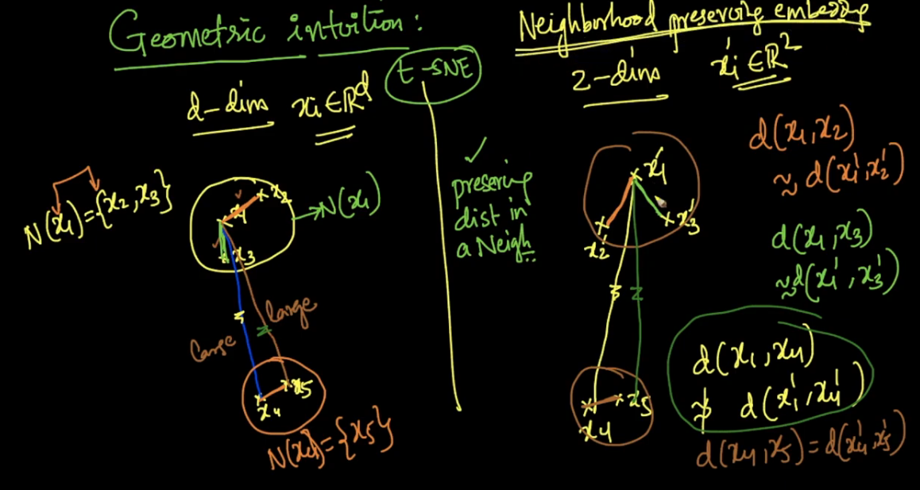
T-SNE
Tsne would basically maintain neighborhood in a lower
dimensional plain.
Tsne employs very sophisticated maths like Gausian Kernels
Etc which would take time, might cover it when we go into SVM
In details later.
Sometimes we get to a problem called crowding problem,
that’s why we go for a T-Distribution.

Slide 12
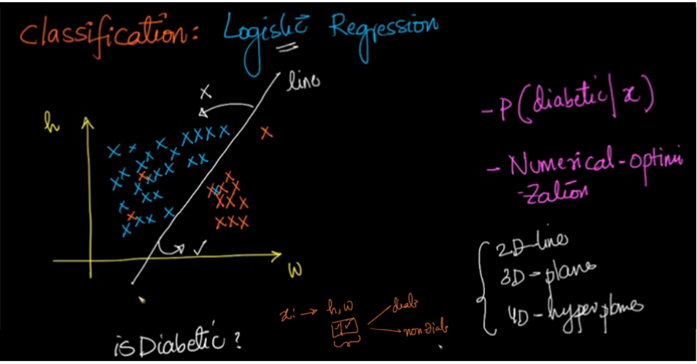
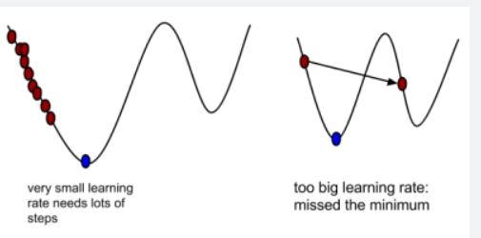
Classification : Logistic regression
Our objective here is to find a line which is able to linearly separate the data points into non diabetic and diabetic,
so that given a new data point, we can say that the point if It lies to the far left, then it is diabetic or if lies to the right,
it is non diabetic.
Now a point which is nearer to the line would have a lower probablity and a point further from the line would have
a higher probablity. Now how do we get the most optimum line ?
This is done using Numerical optimization. Remember Maxima and minima ?

Slide 13
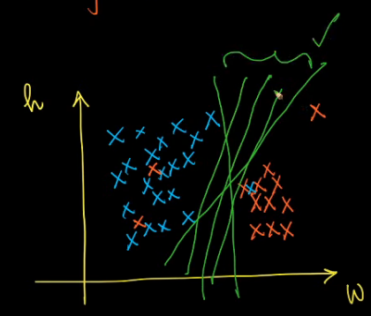
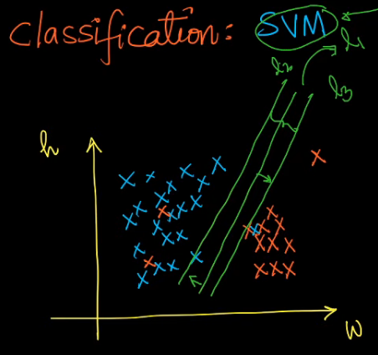
Classification : SVM (Linear and Kernel SVM’s)
Now there are so many lines or planes possible which might separate these
Data points, which would be the best possible line ?
So that’s the question which SVM tries to answer.
SVM tries to find that line such that the 2 hyper planes or lines which is nearst
To it and which passes through the nearest 2 points of the 2 different classes
such that it maximizes the margin. The maths behind this is really beautiful.
This is called Margin maximizing Hyper plane.
This line is also got by solving numerical optimization algorithms. Now this is a
Crux of linear SVM
Let’s check out Non linear SVM. This is what makes SVM damn powerful.
https://ankitnitjsr13.medium.com/math-behind-support-vector-machine-svm-5e7376d0ee4d

Slide 14
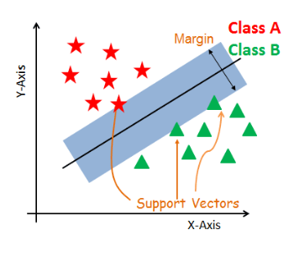
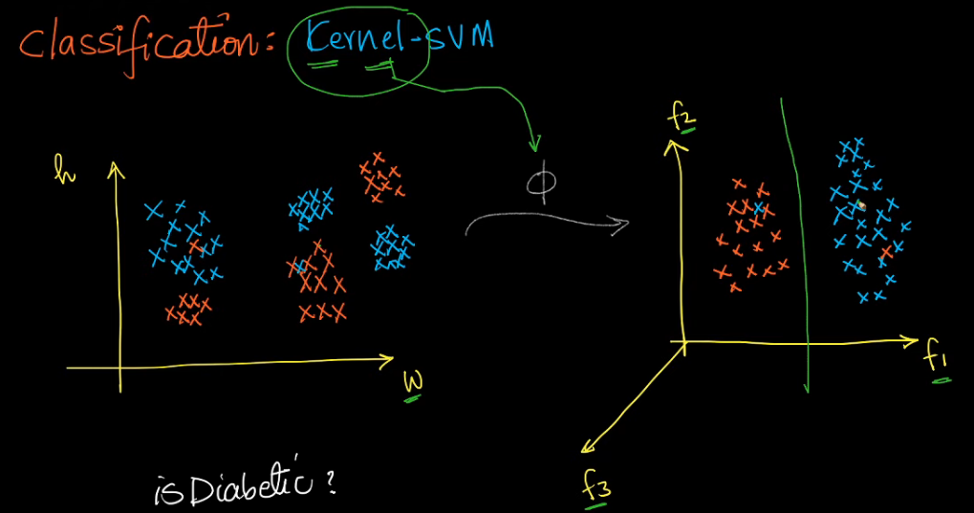
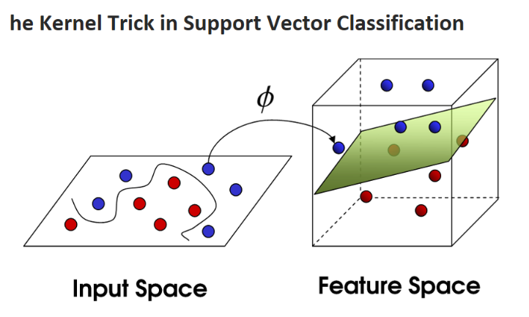
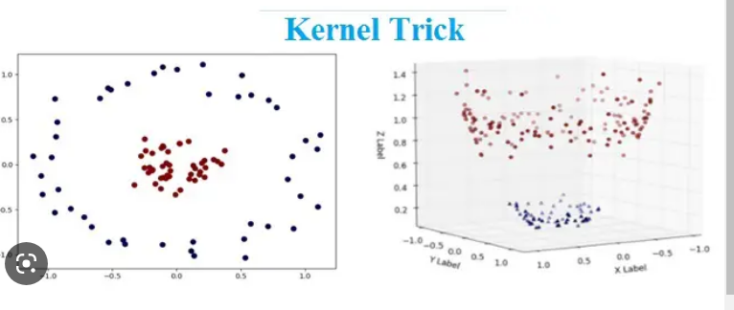
Kernel SVM
Imagine you have a bunch of points on a piece of paper, and you want to draw a line to separate them into two groups.
But the problem is, the points are not nicely arranged, and you can't draw a straight line to separate them.
So instead of trying to draw a straight line in the original space, we transform the data into a new space where
we can draw a line to separate the points. This makes it easier to classify the data, even if the data is not nicely
arranged in the original space. SVM employes a beautiful mathematical construct called the Kernel trick.
Kernel Trick :
https://towardsdatascience.com/the-kernel-trick-c98cdbcaeb3f
https://www.analyticsvidhya.com/blog/2020/10/the-mathematics-behind-svm/

Slide 15
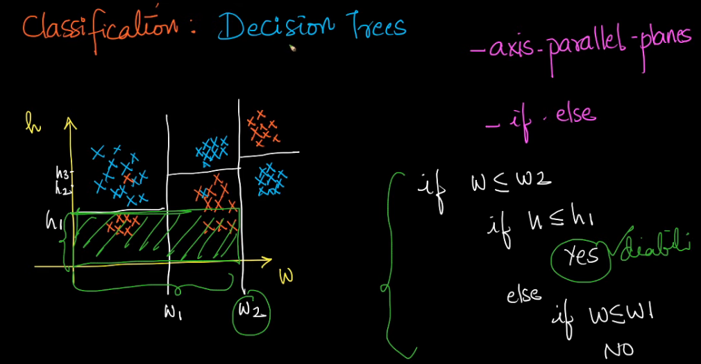
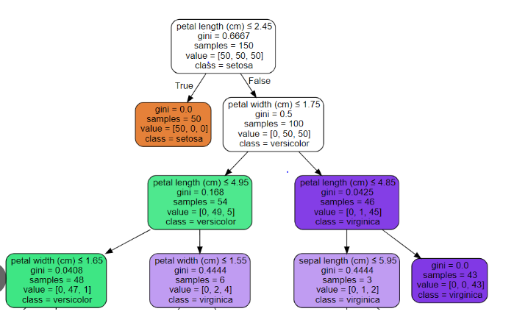
Classification : Decision Trees
The grand idea about Decision tree would be that unlike SVM
Why go for only one decision boundary, let’s go for multiple
Axis parallel planes.
So unline the very complicated maths behnd SVM’s, decision tree
Tries to find these axis parallel lines not y solving numerical
optimization techniques but by simple computer science algos to
Find these horizontal and vertical lines such that the diabetics
and non diabetics are classified as regions.
Now what is the outcome ? Simple nested if else conditions, what is
Important is the point or the values where these branches split off.
The best thing about decision trees are their simplicity
We use GINI Impurity to arrive at the point cuts whereby Gini impurity
is a way to measure how "mixed up" a group of things is.
https://towardsdatascience.com/decision-trees-explained-entropy-information-gain-gini-index-ccp-pruning-4d78070db36c

Slide 16
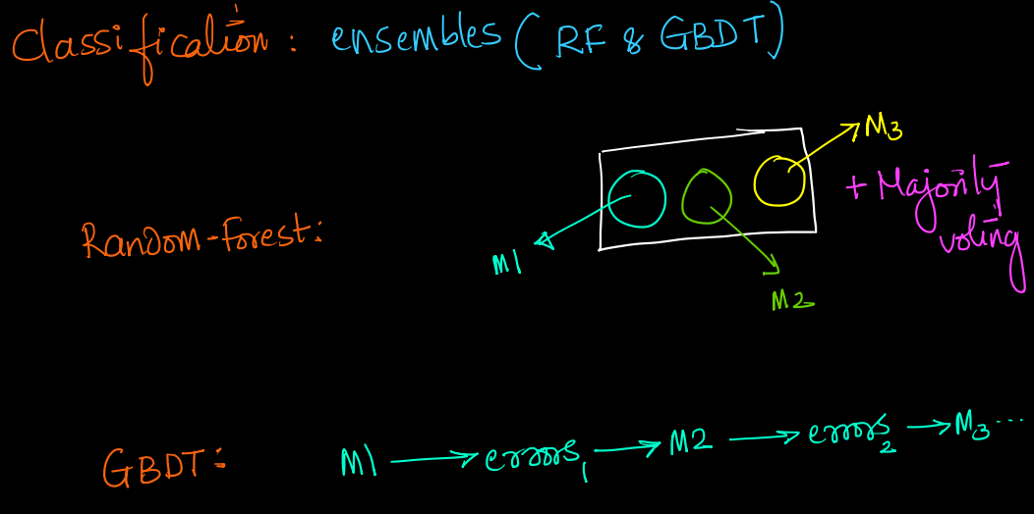
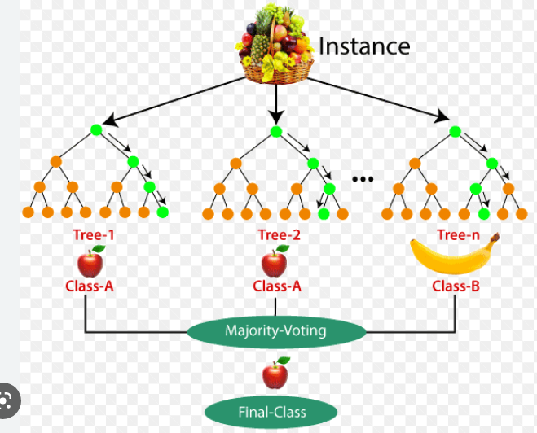
Classification : Ensembles (Random forest & GBDT)
Ensemble basically means a group of models instead of building one model I can build multiple models, it's like
having experts in multiple fields, imagine instead of taking a decision from one person take decision from multiple
experts and finalize the decision based on the feedback from multiple experts.
In this case we train hundred’s of models on some random sets of data and then do a majority voting to determine what is the output.
Pre Deep learning, Random Forests and GBDT were the most commonly used algorithms
You can build ensembles using any model but in practice decision trees are used extensively for ensembles
Random forest and GBDT were the most popular algorithms being used in the tech companies

Slide 17
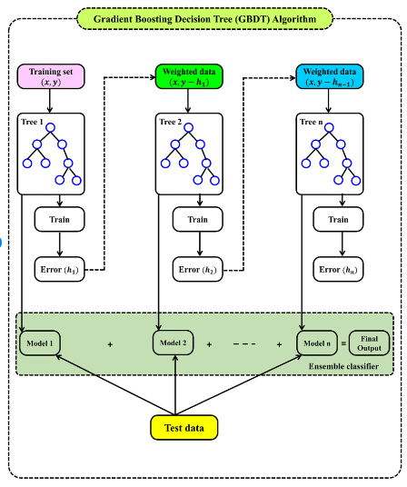
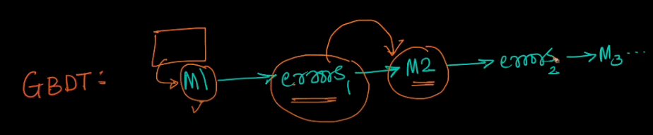
GBDT ( Gradient Boosted Decision Tree)
So basically we build a model which gives some errors,
Now take the errors into consideration to create another
Model so that the new error is reduced and so on and on..
The algorithm works by combining several decision trees together in a process called boosting. A decision tree is a model
that asks a series of questions about the data in order to make a prediction.
Boosting is a way to combine weak models (decision trees that may not be very accurate on their own) into a strong model by
iteratively training new models on the errors made by the previous models.
Gradient boosting is a specific type of boosting that uses the gradient of the loss function to determine how to adjust the
predictions made by the model. This allows the model to focus on the data points that it is having the most trouble with,
and to make better predictions overall.
GBDT has been used successfully in a variety of applications, including recommendation systems, fraud detection,
and image recognition.

Slide 18
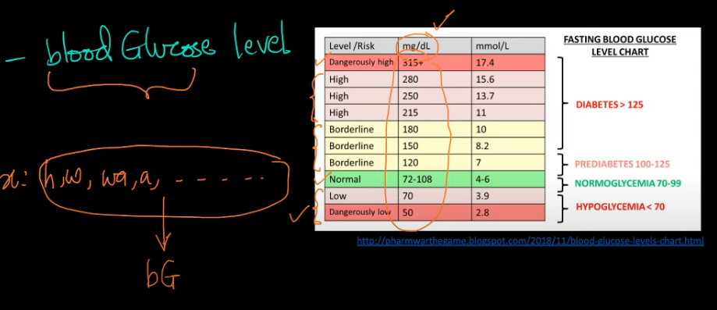
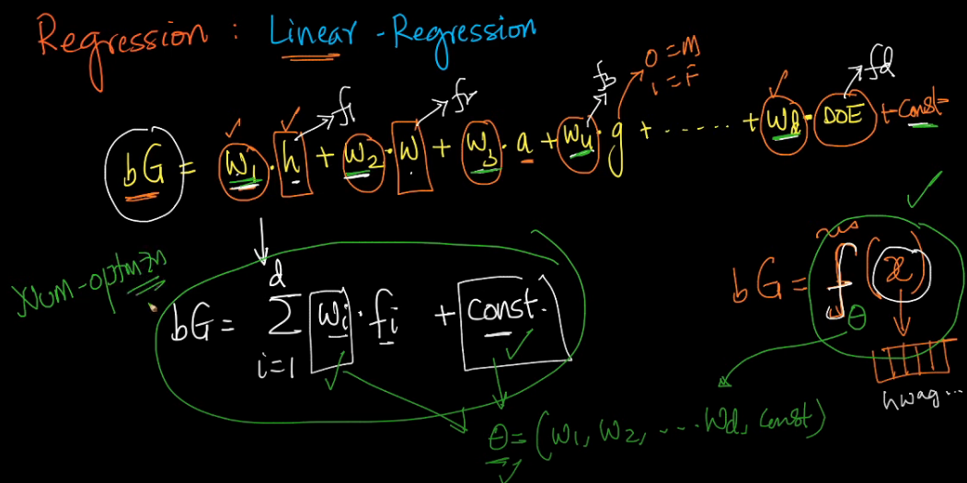
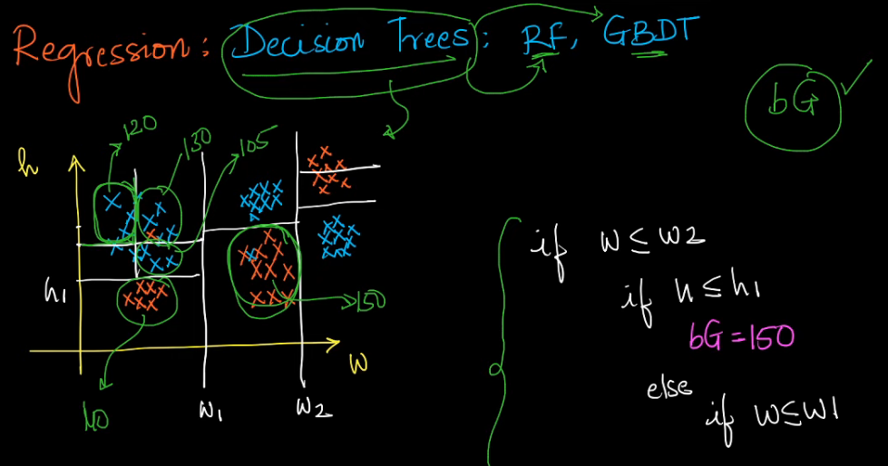
Regression : Estimate numerical value
Given a few parameters like weight, height etc, can we
predict blood sugar.
Now most of the techniques we use for classification can be
applied here
Do note below that given a vector of values we are trying to
get a coefficient and a constant term which can help to create
A function.
So basically the requirement is to get the value o Thetha which
Satisfies the below equation.
The value of thetha is again received by numerical optimization
We could also use Random forest or Decision tree for the same. The only difference is
we are creating the axis parallel plains such that the points in each of these boxes carry the same
Or similar value. Now this could be easily modelled as an if then else condition.
Now since Decision tree can be built for regression, the concepts of GBDT and Random forests are easily applicable.

Slide 19
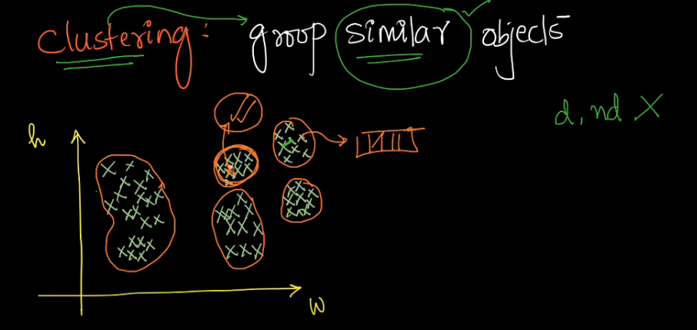
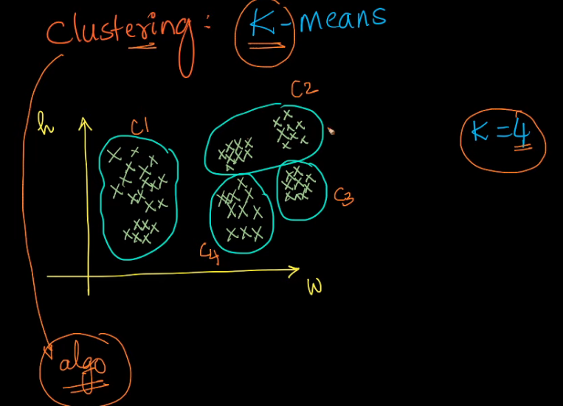
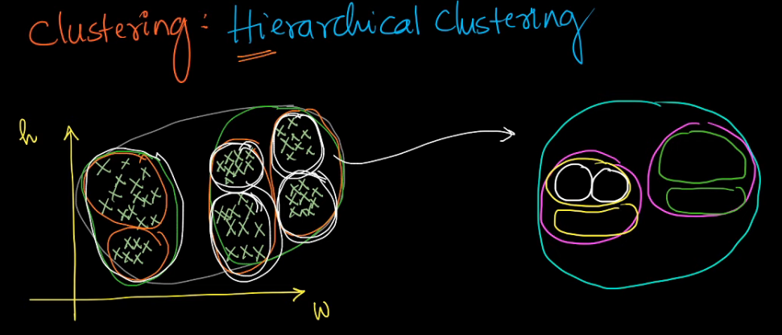
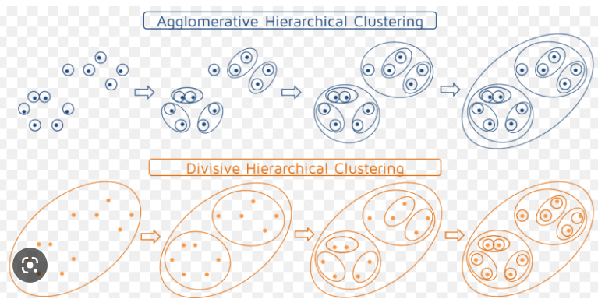
Clustering
Clustering is a type of unsupervised machine learning technique that involves grouping similar data points together
into clusters based on their similarities and differences.
In clustering, the goal is to identify patterns and structures in data without any prior knowledge or labels. Now why is this useful ?
I can look at one user here I could take one user here study this user and most of the
properties or conclusions that I come up with for this user also should be meaningful
for all these users
Clustering algorithms work by partitioning a dataset into groups or clusters based on some similarity measure or distance metric between the data points.
The algorithm identifies groups of data points that are more similar to each other than to those in other groups.
The number of clusters is typically determined by the algorithm or chosen by the user based on the problem requirements.
There are various types of clustering algorithms, including K-means clustering, hierarchical clustering, density-based clustering, and fuzzy clustering, among others.
Each algorithm has its strengths and weaknesses, and the choice of algorithm depends on the problem and the data.
Now give some random data points, with each data point represented as a vector, we can group data points which are
Similar in nature. Now the big question is how do you define similarity. There are a lot of distance measures which can be
used to measure similarity.
K means clustering is an algorithm whereby you give a value of K = 4 and then you are able to create a group of 4 sets of tightly packed datapoints which are similar in nature,
Hierarchial clustering follows a recursive approach whereby you first create 2 groups and then each of the group is further subdivided and so on. So here we do not need to give the value of K. once you have the groupings done , can just work with the desired cluster

Slide 20
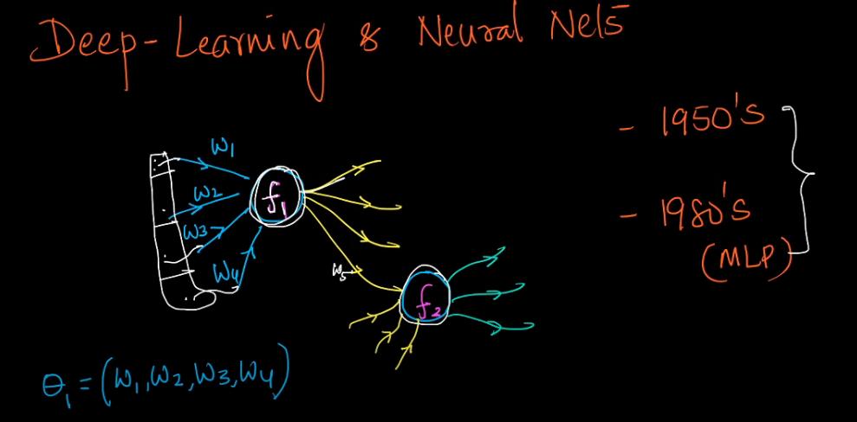
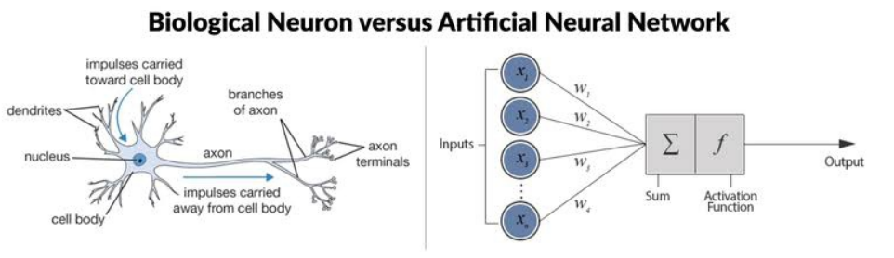
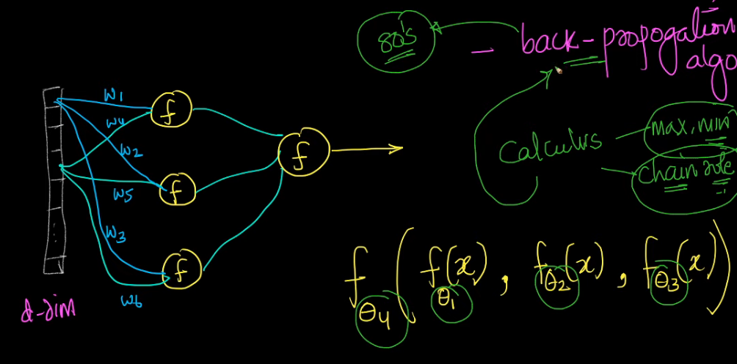
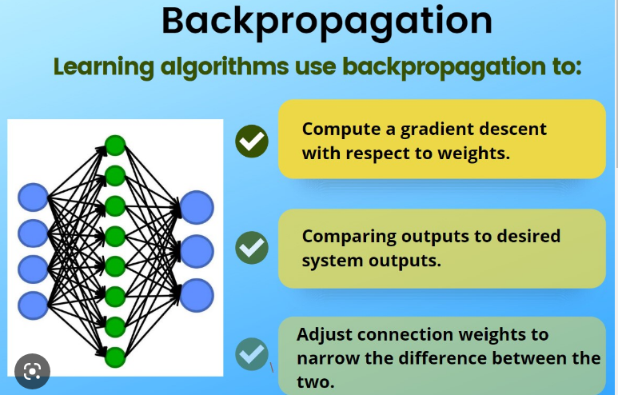
Deep Learning and Neural Networks
A neural network is a type of machine learning algorithm inspired by the structure and function of the human brain. It is composed of interconnected nodes (neurons) that work together to process
and analyze complex data.
In a neural network, each neuron receives input from other neurons, processes this input using an activation function, and then outputs a signal to other neurons in the network.
The strength and nature of the connections between neurons are determined by a set of learnable parameters called weights and biases.
There are many types of fucntions which can be used. People have tried tons of linear as well as nonlinear functions like Sigmoid, Relu etc
Around 1980’s Geoff Hinton and his students came out with an algorithm called back propogation which changed the field forever.

Slide 21
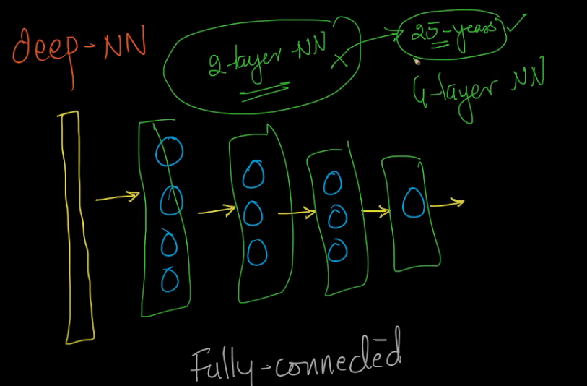
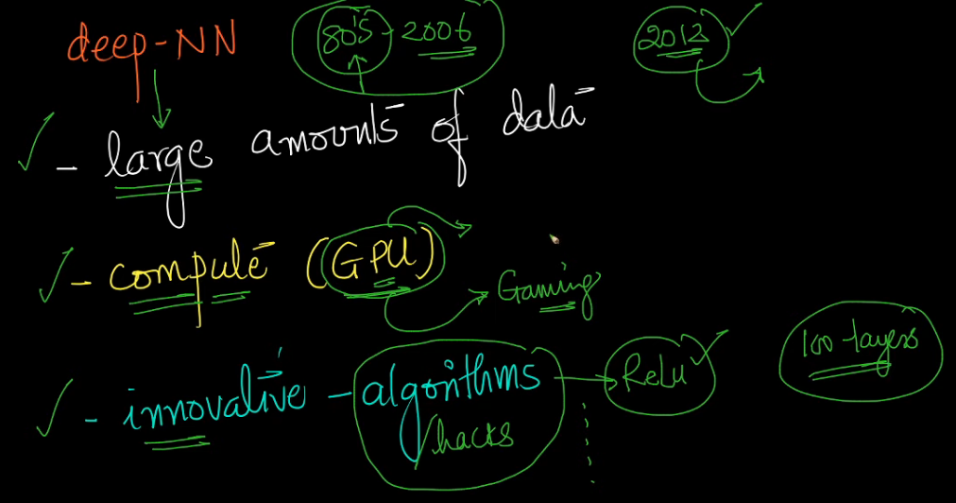
Using Deep neural network, we could pretty much simulate any complex
non linear functions.
For a very long time we were able to build only like a 2 layer neural networks, It took
People like Geoff Hinton, Ya le Kunn, around 25 years to come up with some break throughs
Which made training deep neural networks possible
From 80’s to 2006 the time was called AI winter as training of network;s bigger than 2 layer was problematic
From 2008 to 2012, we had a lot of breakthroughs like RELU etc which made training large neural networks possible
Basically there were 3 reasons why Deep neural network became popular from
80’s and 2006
https://medium.com/analytics-vidhya/you-dont-understand-neural-networks-until-you-understand-the-universal-approximation-theorem-85b3e7677126

Slide 22
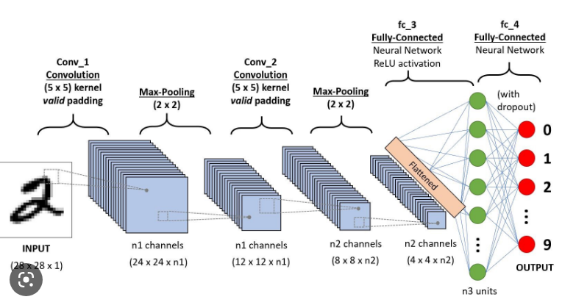
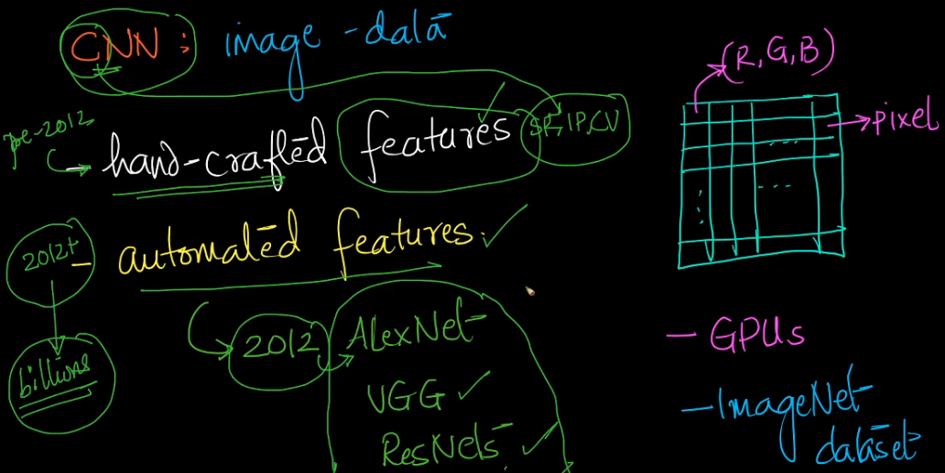
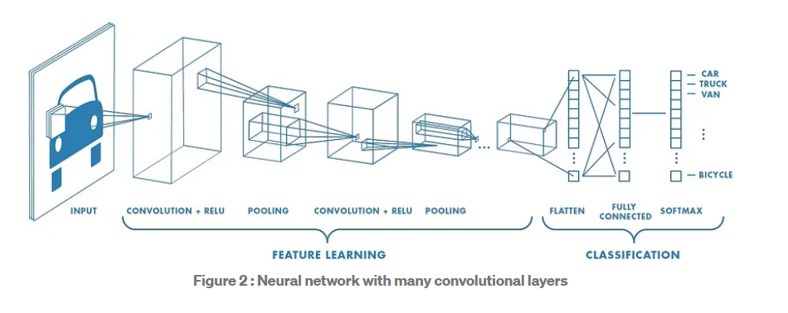
Convolutional Neural Network
A Convolutional Neural Network (CNN) is a type of neural network commonly used in image and video analysis,
natural language processing, and other applications that involve processing structured or sequential data.
CNNs are specifically designed to process data with a grid-like topology, such as images or time series data. They use
convolutional layers to apply a set of filters to the input data, detecting local patterns and features. The output of the
convolutional layer is then passed through pooling layers to reduce the dimensionality of the data, and then through
one or more fully connected layers to produce a final output.
The use of convolutional layers in CNNs allows them to efficiently learn complex patterns and relationships within images
and other grid-like data. CNNs have been highly successful in a range of applications, including image classification,
object detection, and image segmentation.

Slide 23
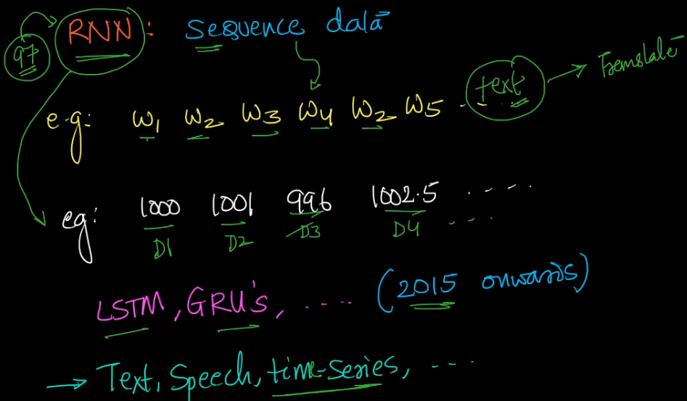
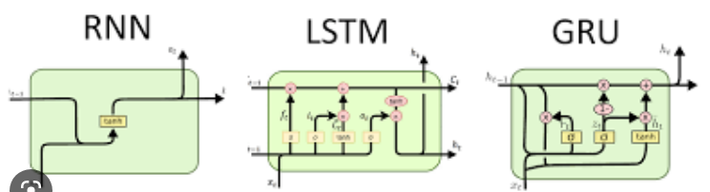
Recurrent Neural Network
A Recurrent Neural Network (RNN) is a type of neural network commonly used for sequential data analysis, such as natural language processing,
speech recognition, and time series prediction.
Unlike traditional feedforward neural networks, which process input data one time step at a time, RNNs are designed to process sequential data
by passing the output from the previous time step as input to the current time step. This allows RNNs to use feedback loops to capture
dependencies between time steps and maintain an internal state that evolves over time.
RNNs use a type of neuron called the recurrent neuron, which has a self-connected weight that allows it to pass its output back
to itself as input at the next time step. By using these recurrent connections, RNNs can model the temporal dynamics of sequential
data and learn to make predictions based on the history of the data.
One of the key advantages of RNNs is their ability to handle input sequences of variable length, as the recurrent connections allow
them to process input data of any length. This makes them well-suited for applications where the length of the input sequence may vary,
such as in natural language processing or speech recognition.
Using RNN’s we were able to handle speech data, text data time series
Etc where sequence is important
https://colah.github.io/posts/2015-08-Understanding-LSTMs/

Slide 24
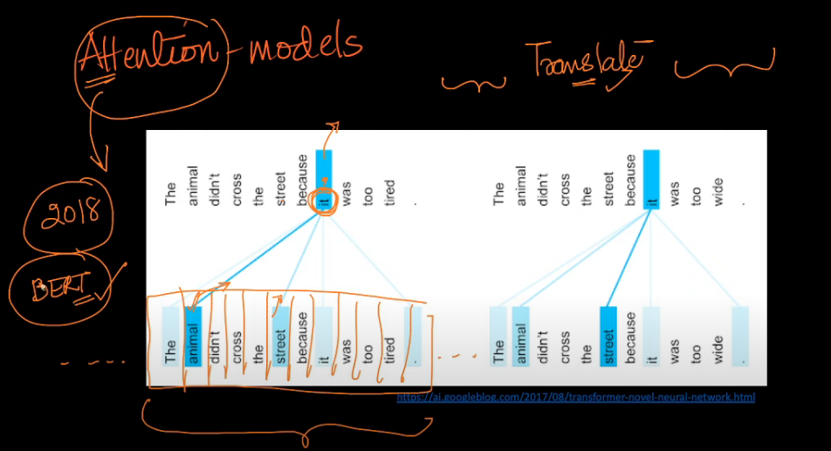
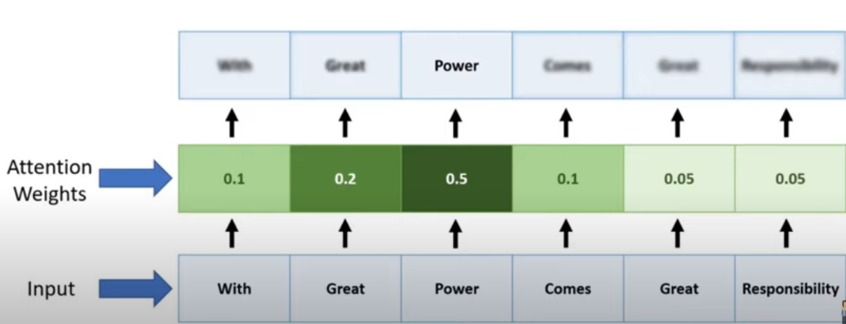
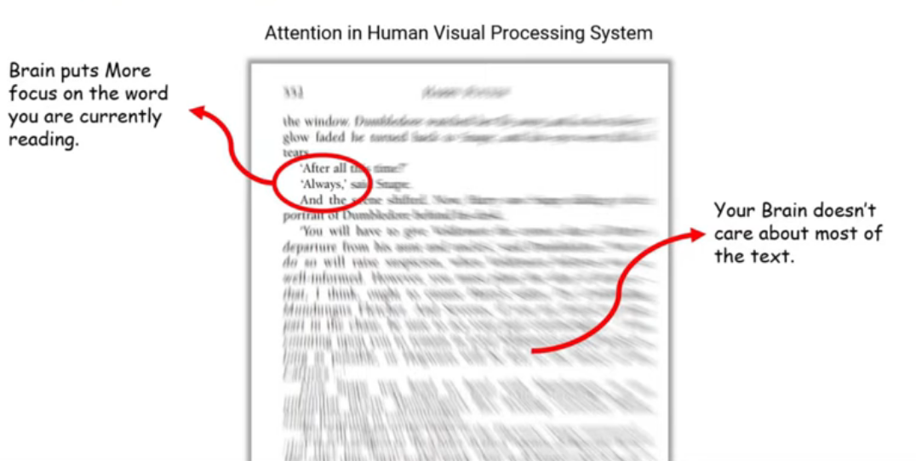
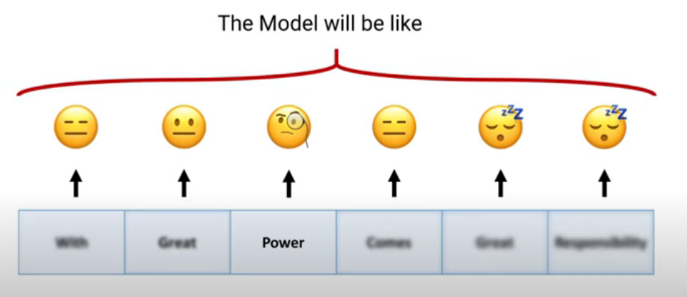
Attention Models (2018)
This was bought in light around 2018 by Google where they found out some ineffeciencies in RNN;s
And was basically used in the space of text translation.
An attention model is like a superhero that can pay attention to the most important parts of a story or a video.
Just like how you pay more attention to the exciting parts of a movie or a book, an attention model can focus on the most important parts of a story,
a video, or even a picture.
Imagine you're reading a storybook with many pictures. The attention model will look at each picture and decide which ones are
the most important to understand the story. It might focus on the picture of a superhero saving the day, instead of the picture of
a tree or a bird. That way, the attention model can understand the story better and make better predictions about what will happen next.
In the same way, attention models can be used to help computers understand stories or videos. By focusing on the most important parts,
computers can understand what's happening and make better predictions. This can help them do things like translate languages, caption videos,
and even help people who have trouble hearing to understand speech better.
So, that's what attention models are! They're like superheroes that help computers pay attention to the most important parts of a story or a video.

Slide 25
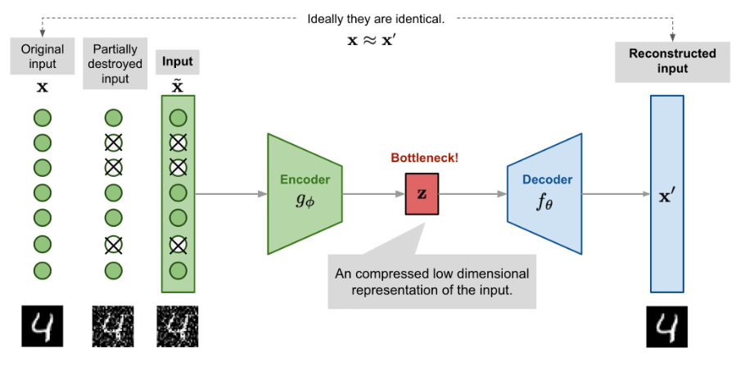
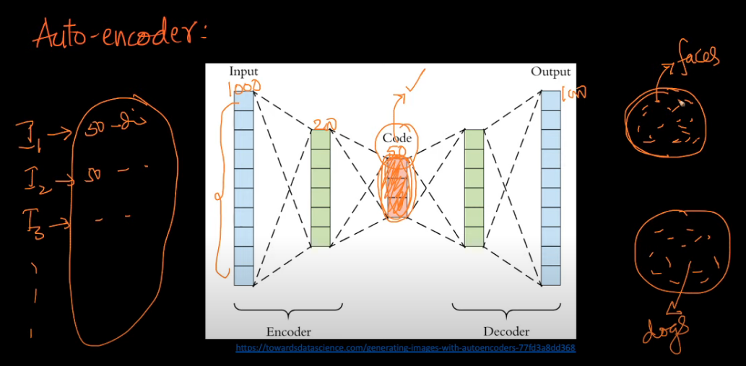
Auto Encoder
In an image compression scenario, the input image is first fed into an encoder network, which compresses the image into a lower-dimensional representation, often referred to as a "latent space". This latent space representation contains the most important and relevant features of the input image, while removing
any redundant or unnecessary information.
The compressed representation is then passed to the decoder network, which reconstructs the compressed image back to its original size and form.
By training the autoencoder on a large dataset of images, the encoder and decoder networks can learn to compress and reconstruct images with high fidelity, while minimizing the loss of information.
During compression, the encoder network typically reduces the dimensionality of the input image by a factor of 10 or more, resulting in a highly compressed representation. This allows for efficient storage and transmission of the compressed images, as they require less memory and bandwidth.
When a compressed image needs to be viewed or used, the decoder network can reconstruct the compressed image back to its original size and form, without any loss of information. This makes autoencoder-based image compression an effective and widely-used technique in many applications, including image and video streaming, digital photography, and medical imaging.
https://towardsdatascience.com/generating-images-with-autoencoders-77fd3a8dd368
In this example, we can give a bunch of images, get the latent space vectors
and then could apply clustering on these vectors to group images of similar
type together

Slide 26
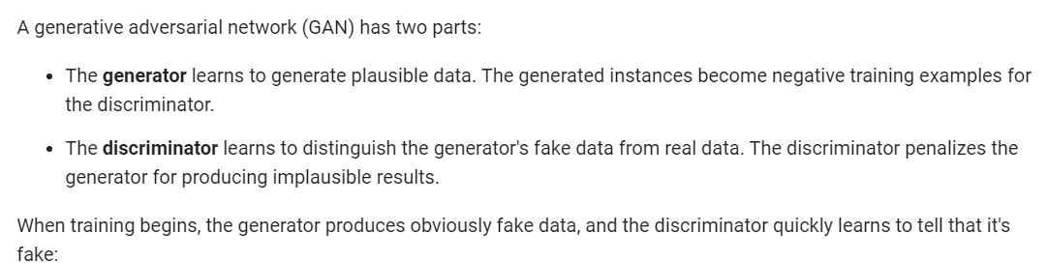
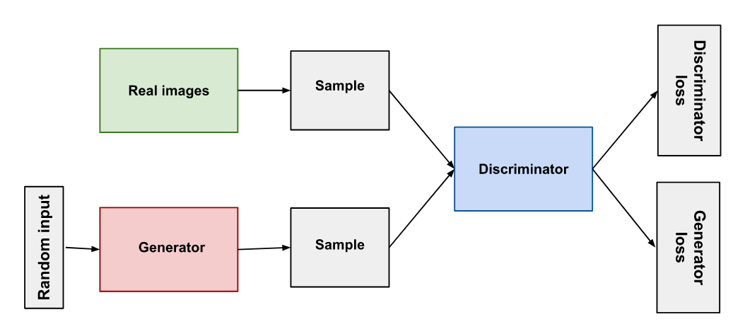


GAN ( Generative Adversial Network)

Slide 27

Different types of GAN’s

Slide 28



Reinforcement learning
In the above network, we try to train the agent using some
Smart Deep neural networks, such that it is able to take the
best possible action, based on the state of the system and the
rewards it can win

Slide 29


